Slide 1

SkillUP
AI-POWERED
CAREER DEVELOPMENT
& RECRUITMENT PLATFORM
skillup.com
BRIDGING THE GAP BETWEEN GRADUATES AND INDUSTRY
Start Slide

Slide 2
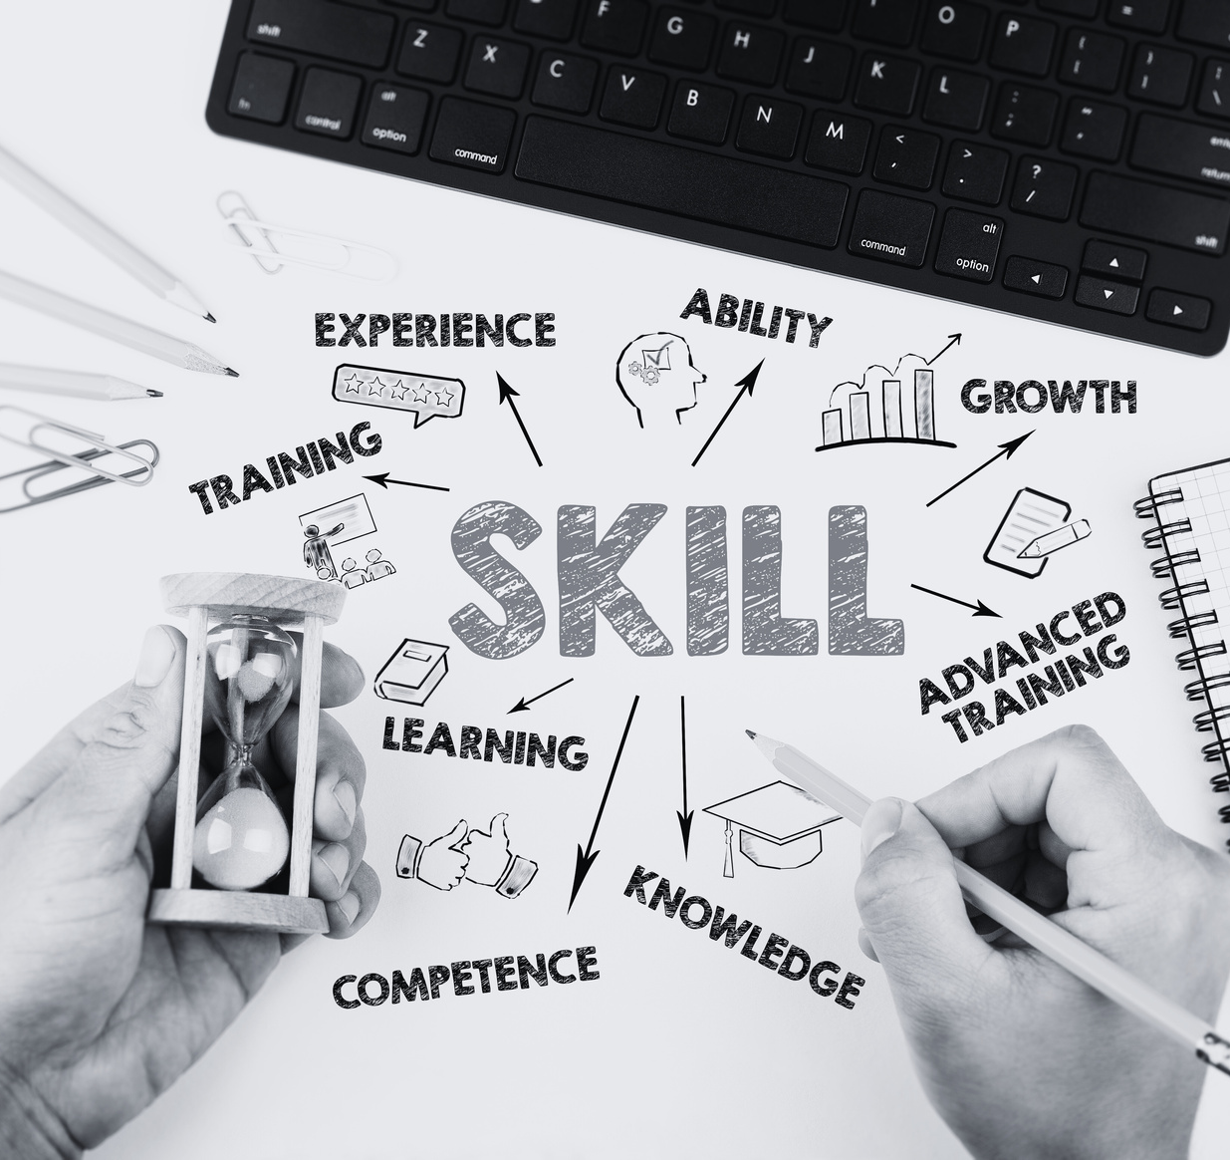
SkillUP
About The Project
What is
SKILLUP?
An AI-powered career development platform.
Designed to bridge the skill gap between graduates and industry.
Empowers students and simplifies recruitment for companies.

Slide 3

SkillUP
About The Strategy
Background
Study
Understanding the Job Market Challenge
Skill Mismatch
Inefficient Hiring
60% of graduates lack job-ready skills.
Employers struggle with evaluating fresh talent.
Lack of Guidance
Graduates have limited career mentorship & tools.

Slide 4

SkillUP
Objectives
What SkillUP Aims to Achieve
As SkillUP tackles the core challenges of graduate under‑preparedness and inefficient hiring, it sets out three clear goals to transform career readiness and recruitment outcomes:
Graduates address only the AI‑identified technical and soft‑skill gaps, maximizing upskilling efficiency.
Real-world micro-projects that build practical experience & Pre-vetted, AI-matched candidates ready for hiring.
About The Plan

Slide 5
SkillUP
About The Service
Methodology
AI-Driven, Scalable, and Data-Centric Approach
Uses AI algorithms to assess and guide users.
Continuously adapts to evolving job market.
Scalable for students and enterprises.

Slide 6




SkillUP
About The Features
Core Feature 01
AI Skill Assessment & Learning Paths
Point 01
Point 02
Point 03
Point 04
AI evaluates technical and soft skills against industry standards.
Personalized learning modules target identified gaps.
Micro-projects simulate real job tasks.
Adjusts content based on market trends.

Slide 7
SkillUP
About The Features
Core Feature 02
Smart Job Matching & Internships
Point 01
Point 02
Point 03
Point 04
Matches jobs to users based on skill profiles & interests.
Micro-projects offer real-world experience without prior work history.
Employers get candidate insights via dashboards.
Companies test candidates before full-time hiring.

Slide 8
SkillUP
About The Features
Core Feature 03
AI Resume & Career Tools
Point 01
Point 02
Point 03
Point 04
Resume scanner & builder tailored to job roles.
Cover letter generator using job-specific inputs.
AI-led mock interviews with feedback.
Identifies skill gaps in real-time.

Slide 9
SkillUP
About The Features
Core Feature 04
Growth Analytics Dashboard
Point 01
Point 02
Point 03
Visualizes progress in resume quality, skill acquisition, and interview prep.
Self-assessment tools and personalized suggestions.
Enables strategic career planning.

Slide 10
SkillUP
About The Features
Core Feature 05
Company Recruitment Suite
Point 01
Point 02
Point 03
Dedicated entry-level job board.
AI matches candidates to company needs.
Recruiter filters by skills, certifications, or project outputs.

Slide 11
SkillUP
About The Highlight
Key
Highlights
Point 01
Point 02
Point 03
Point 04
AI-Powered Skill Gap Analysis
Personalized, Adaptive Learning
Smart Job Matching with Real-World Validation
Resume & Interview Tools Built for Market Success

Slide 12
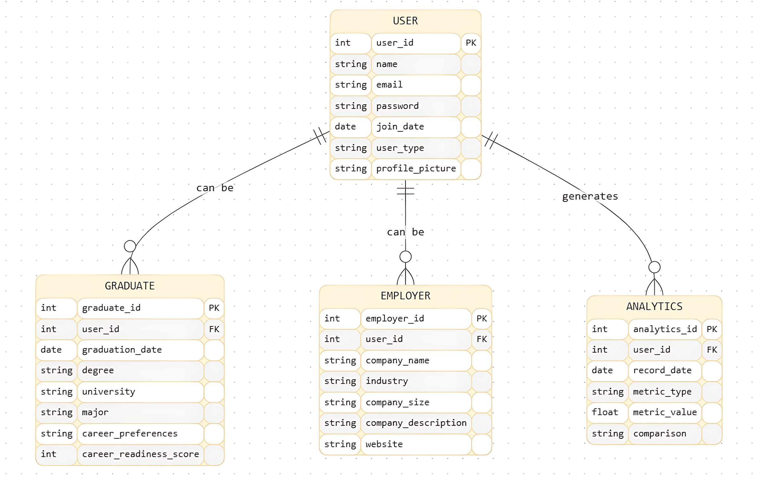
System Design
ER Diagram
Core User Management

Slide 13
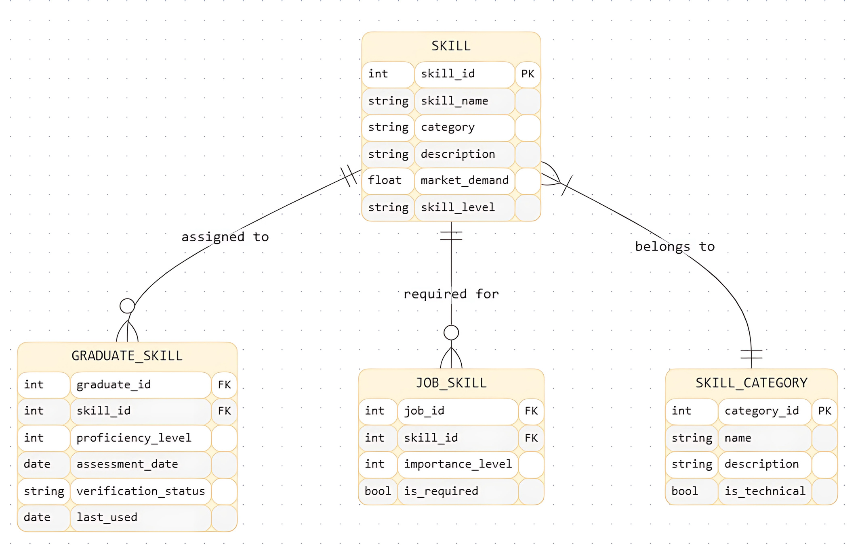
System Design
ER Diagram (Cont.)
Skills and Categories

Slide 14
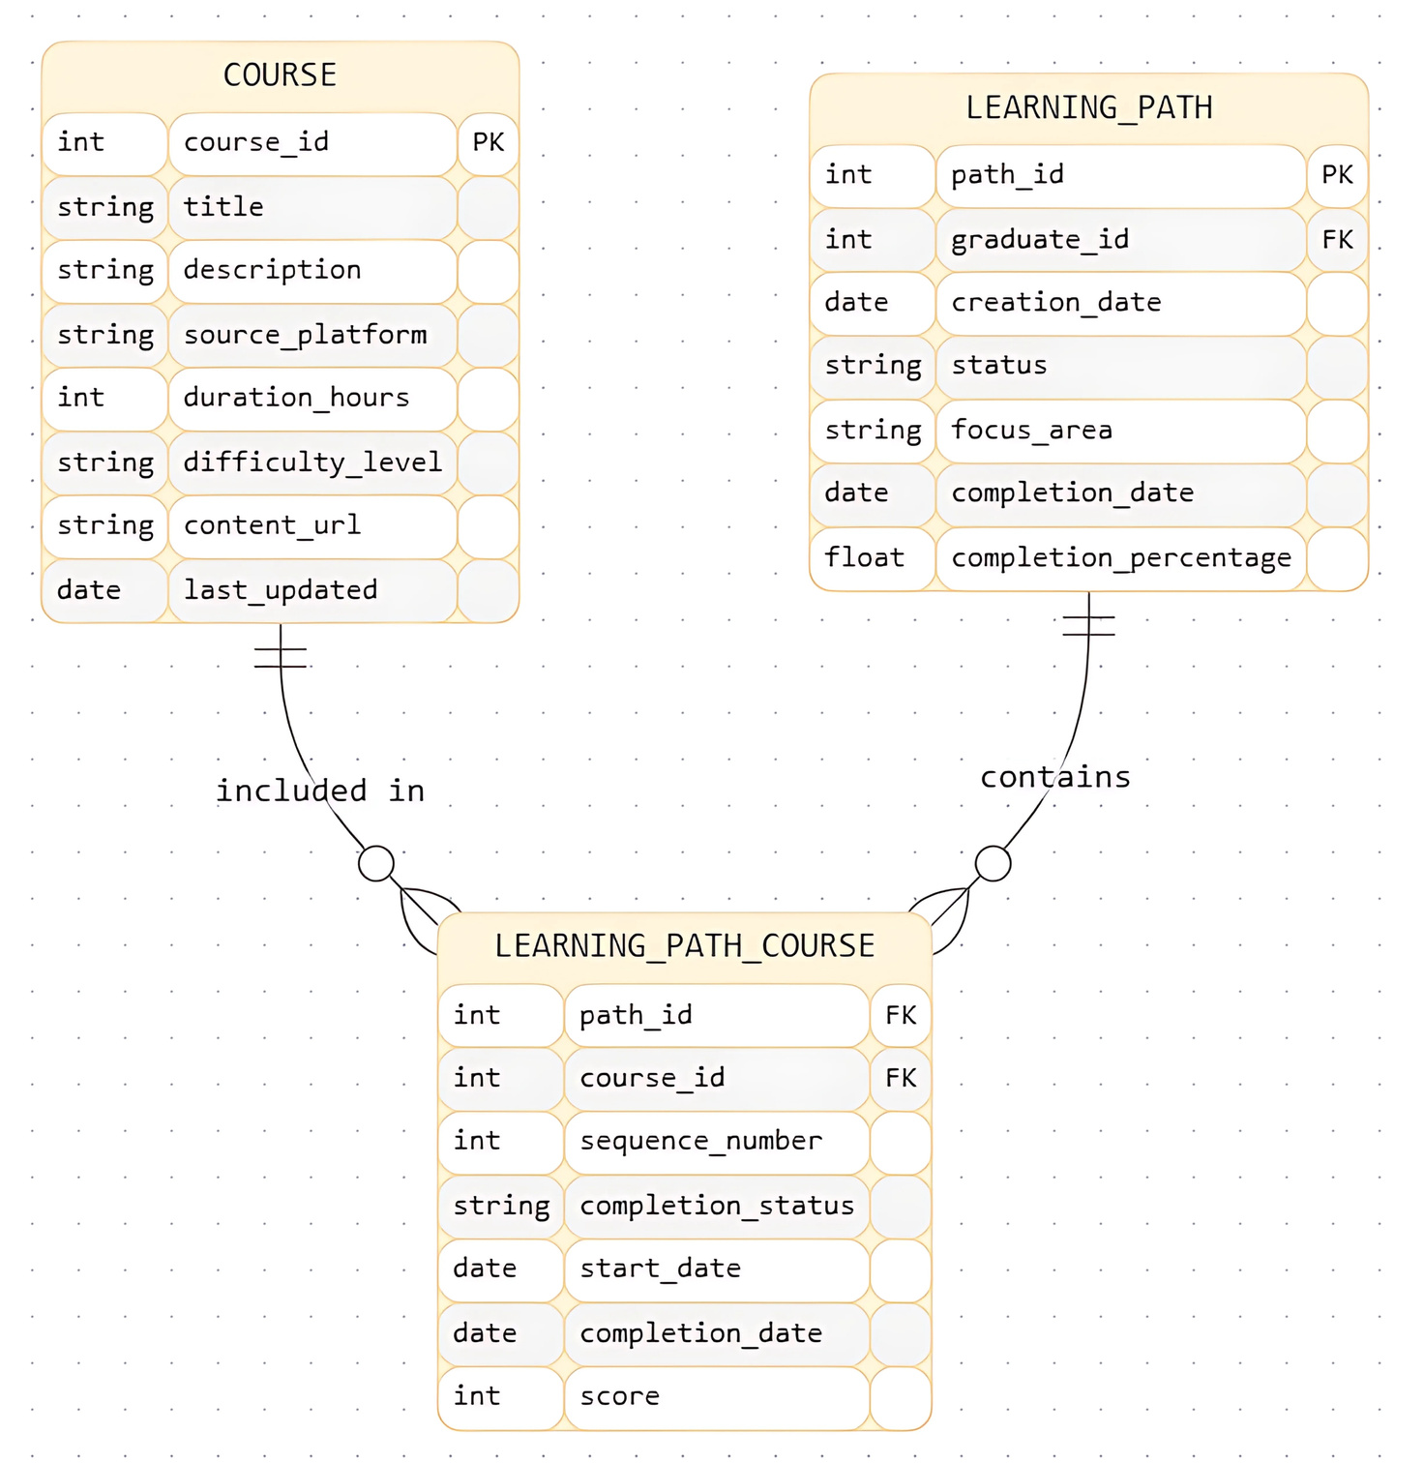
System Design
ER Diagram (Cont.)
Learning and Development

Slide 15
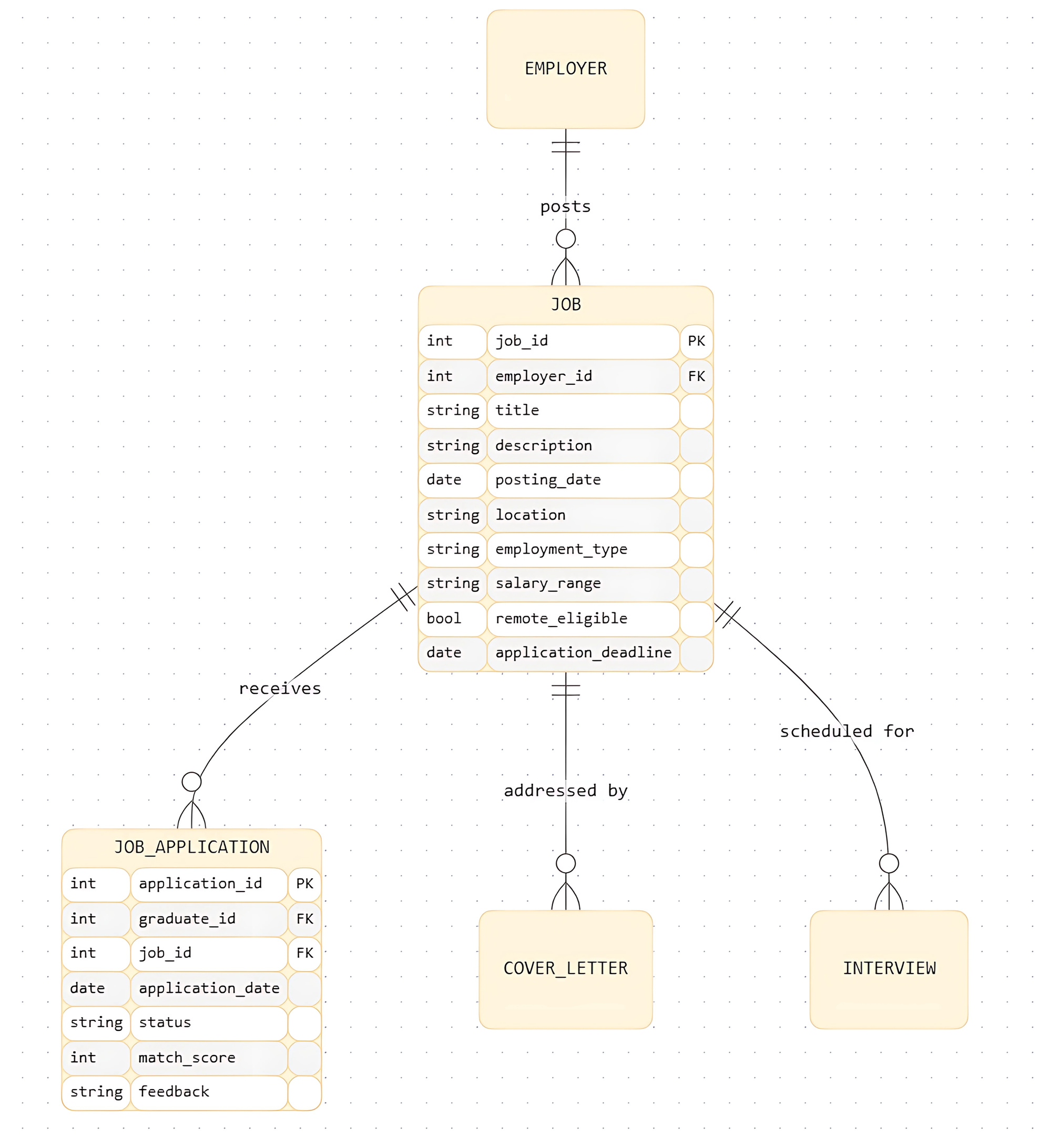
System Design
ER Diagram (Cont.)
Jobs and Applications

Slide 16
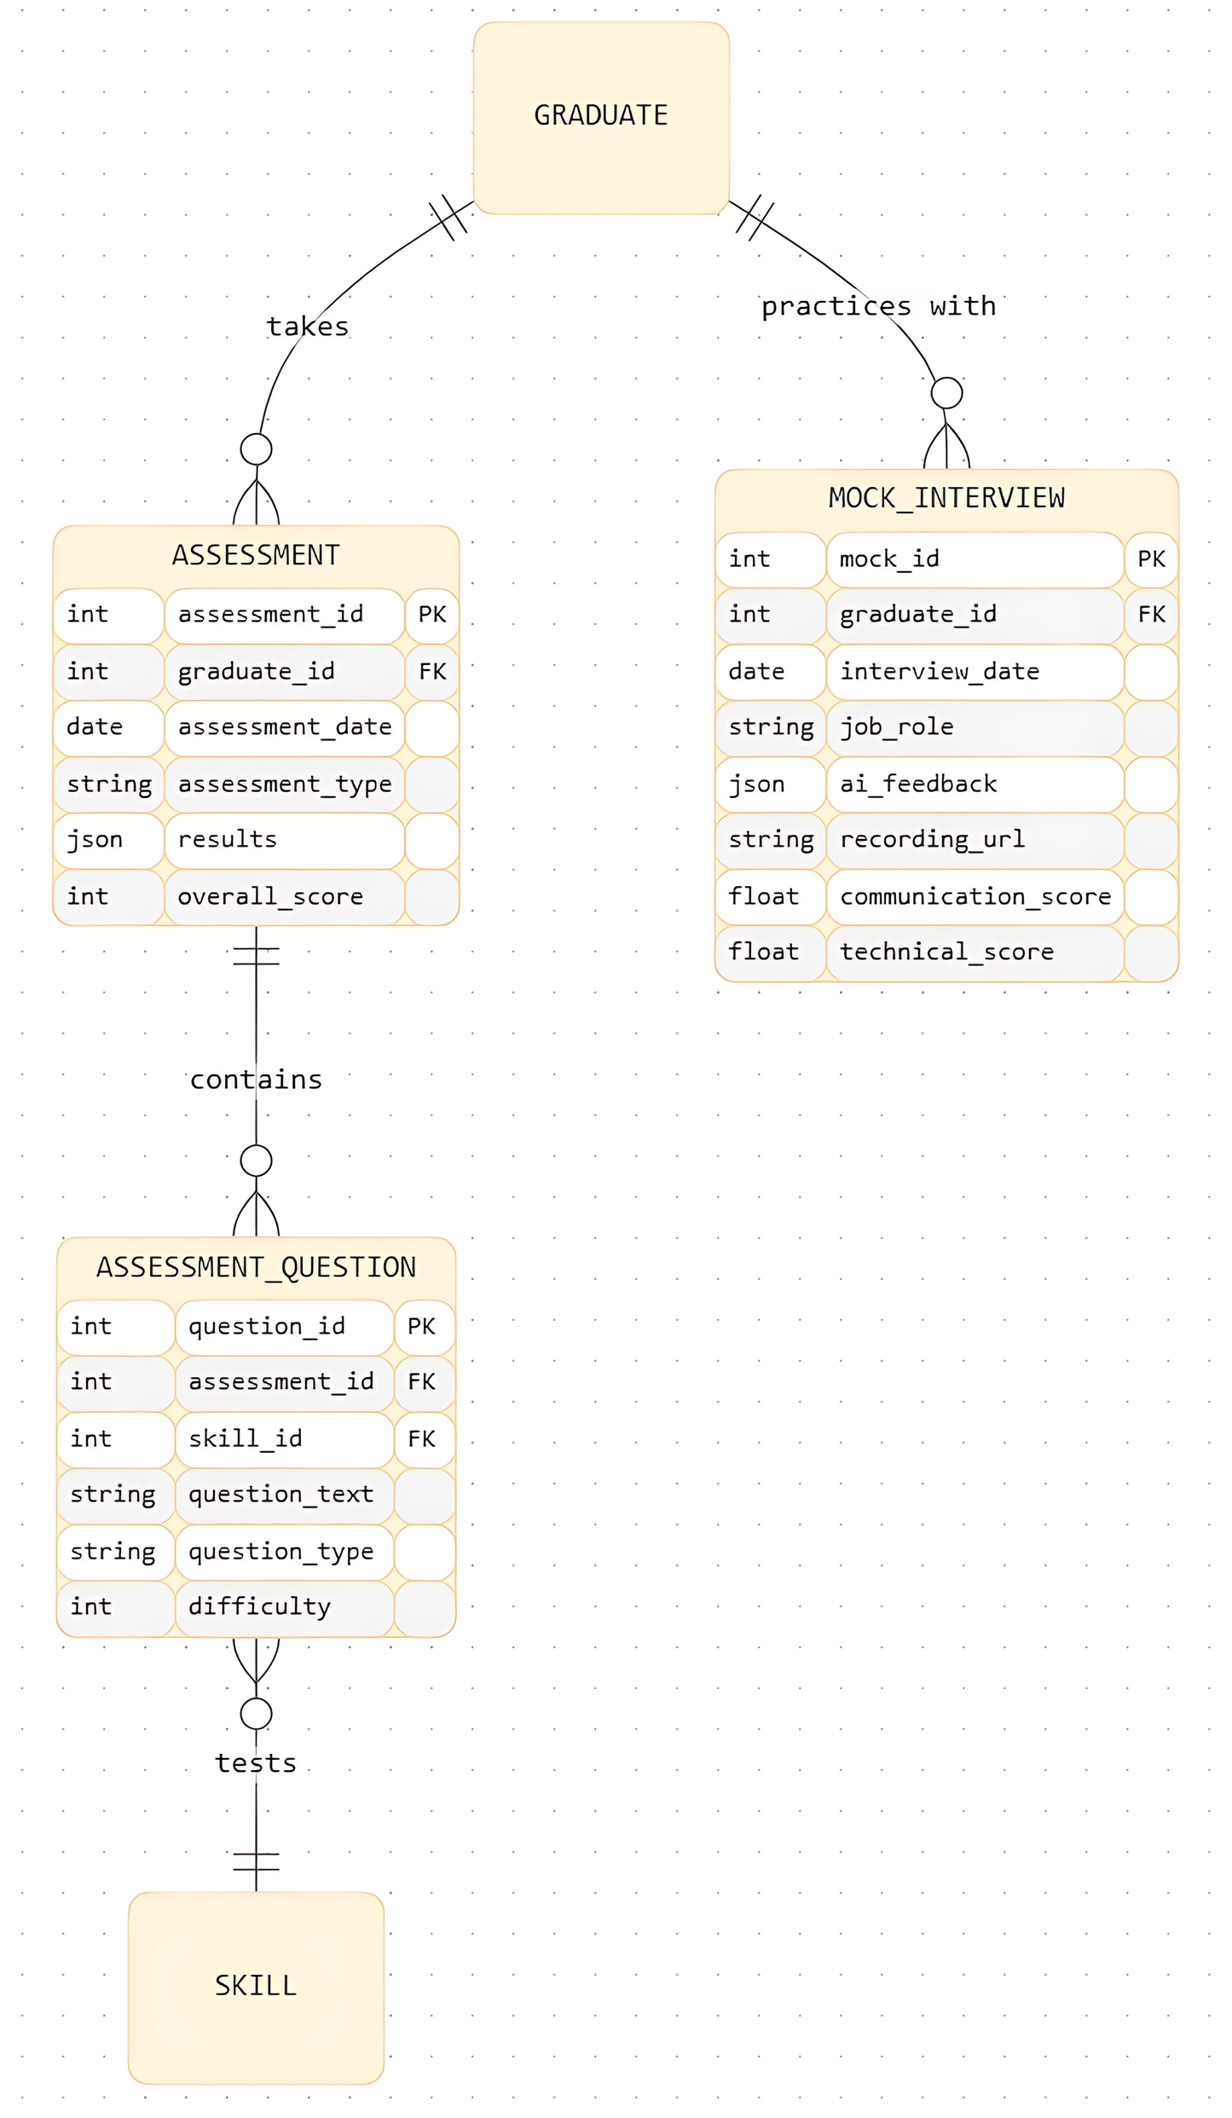
System Design
ER Diagram (Cont.)
Assessments and Interviews

Slide 17
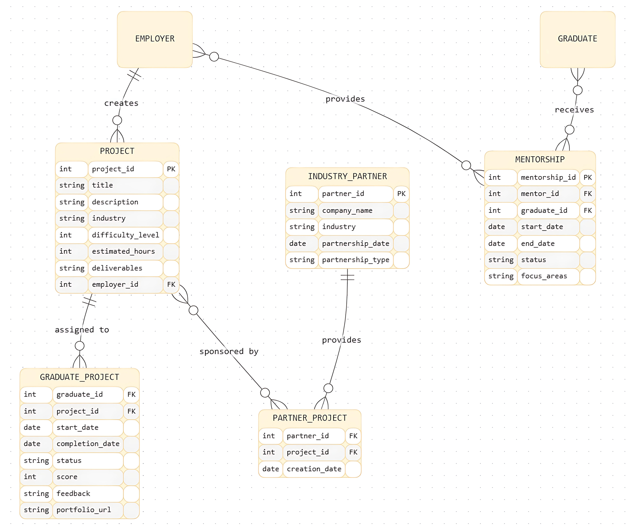
System Design
ER Diagram (Cont.)
Projects and Mentorship

Slide 18
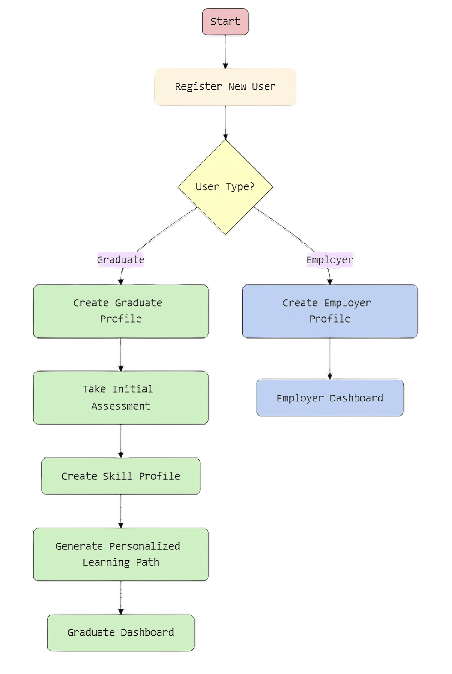
System Design
FLOWCHART
Core Registration Flow

Slide 19
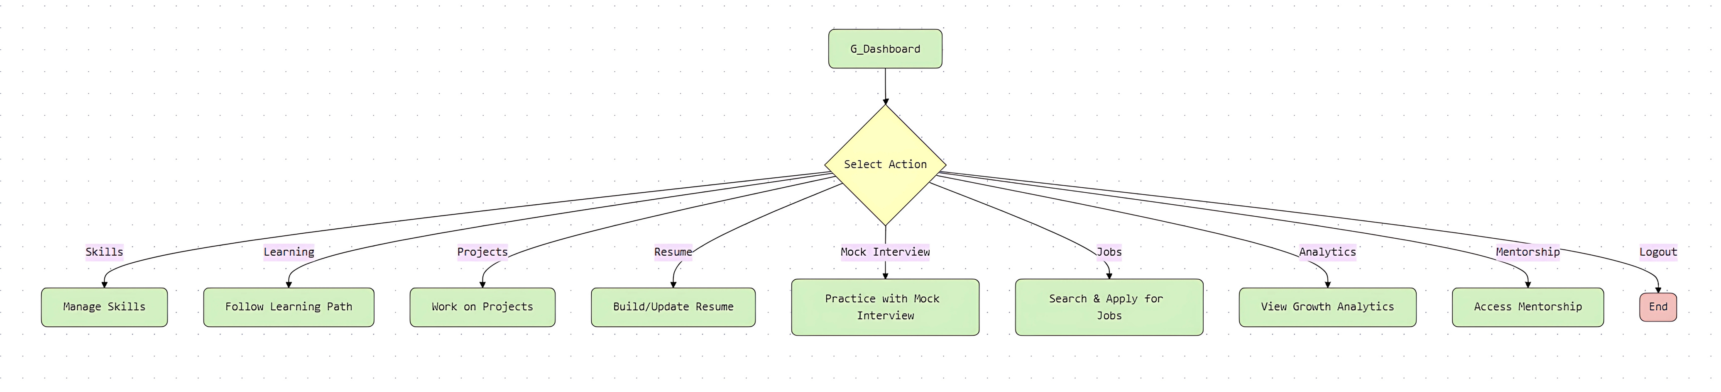
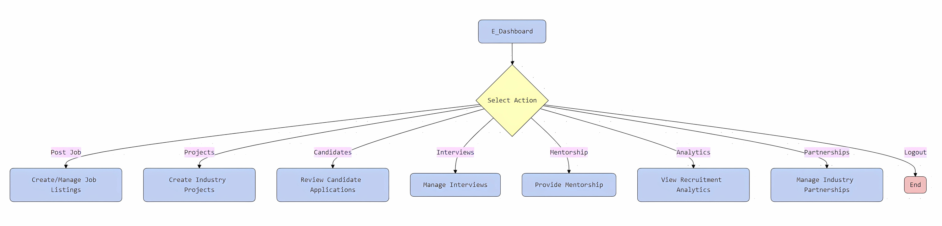
System Design
FLOWCHART (Cont.)
Graduate Dashboard Options
Employer Dashboard Options

Slide 20
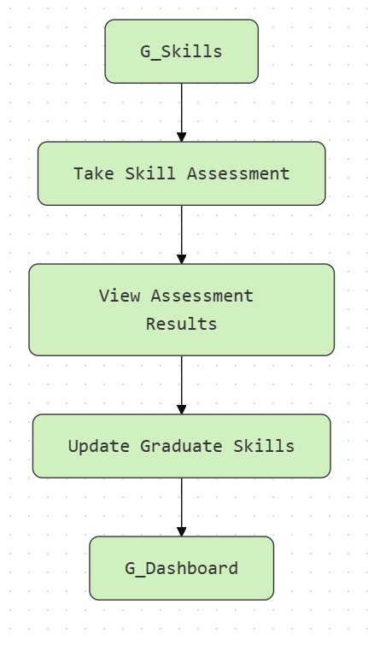
System Design
FLOWCHART (Cont.)
Graduate Skills Management Flow

Slide 21
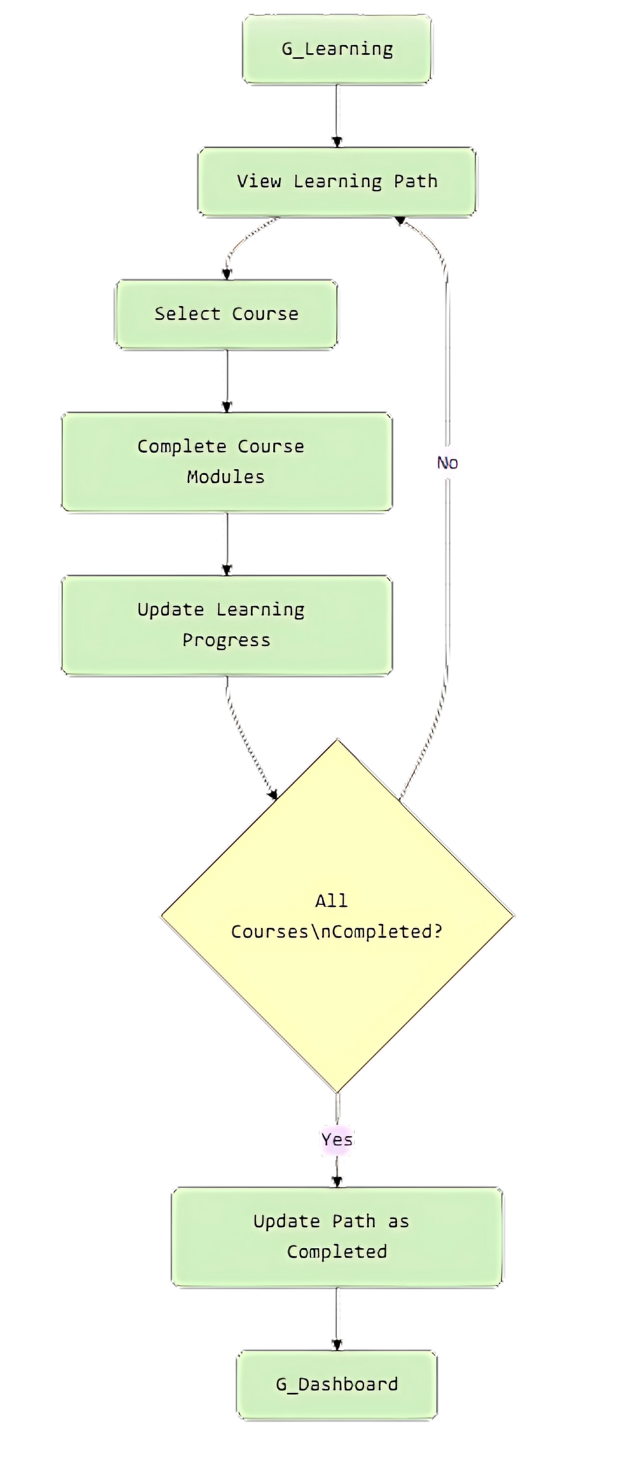
System Design
FLOWCHART (Cont.)
Graduate Learning Path Flow

Slide 22

SkillUP
Conclusion
SkillUP is transforming how graduates prepare and how companies hire.
Delivers practical, scalable, and data-driven career development.
Keeps graduates competitive and companies efficient.

Slide 23
SkillUP
THANK YOU
skillup.com
WE WELCOME YOUR QUESTIONS AND FEEDBACK.
End Slide

